Slide 1



WORKSHOPS ON
EMPOWERING MINDS:
INFORMATION LITERACY
WORKSHOP REPORTS 2023
Workshop Organized by
DTU CENTRAL LIBRARY
www.library .dtu.ac.in
library @ dtu.ac.in

Slide 2




BUSINESS
W O R K S H O P O N
ENGINEERING VILLAGE
24.JAN.2023

Slide 3


INTRODUCTION
The Central Library organized training session on Engineering Village on 24.01.2023, Tuesday at 11;30 am in the conference hall at 3rd floor of central library, DTU.
The workshop conducted by an expert and product manager Mr. Matthew McGarvaand Mr. Vincent Paul.
Dr. Lalita, Assistant Librarian coordinated the workshop under the supervision of Librarian, Prof. Rachna Garg. The Training was a great success.

Slide 4

E X P E R T S P E A K E R & ORGANIZING T E A M
1
Mr. Matthew McGarva
Information Science | Thesauri Development | Indexing & Retrieval Strategies | Engineering & Physics Content
ELSEVIER
2
Mr. Vincent Paul
Solution Sales Manager South Asia, ELSEVIER
3
Prof. Rachna Garg
4
Dr. Lalita
Librarian
Assistant Librarian
_{Delhi Technological University} Delhi Technological University
Supervisor
Corrdinater

Slide 5


ABOUT EXPERT
Mr. Matthew McGarva
The workshop conducted by an expert and product manager Mr. Matthew McGarva. He is responsible for the development and maintenance of thesauri, indexing & search and retrieval strategies that ensure both precision and recall of content for Engineering Village and its flagship database, Ei Compendex. Matt joined Elsevier from the Institute of Engineering & Technology (IET), where he was responsible for taxonomy, classification & indexing enhancements for Inspec. Matt has B.Eng. (Hons) in Electronic Engineering, and over 15 years of experience working within information science in the engineering and physics domains.

Slide 6


ABOUT EXPERT
Mr. Vincent Paul
Mr. Vincent Paul, Solution Sales Manager, South Asia, ELSEVIER | Research Solutions Sales.

Slide 7


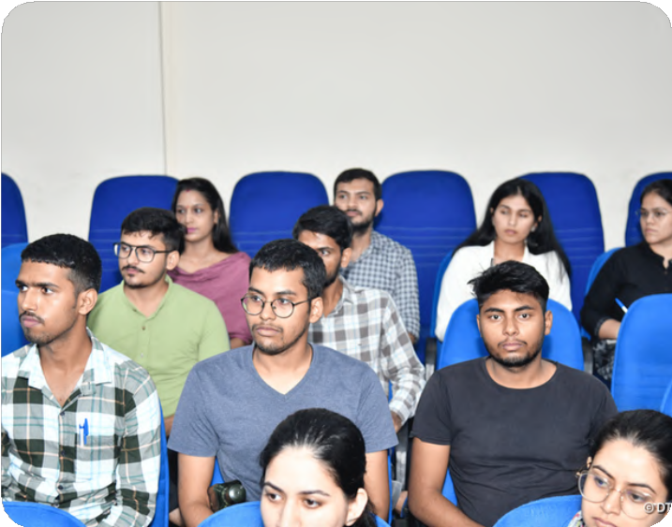

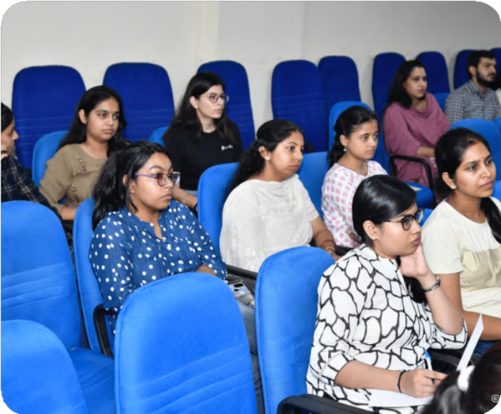




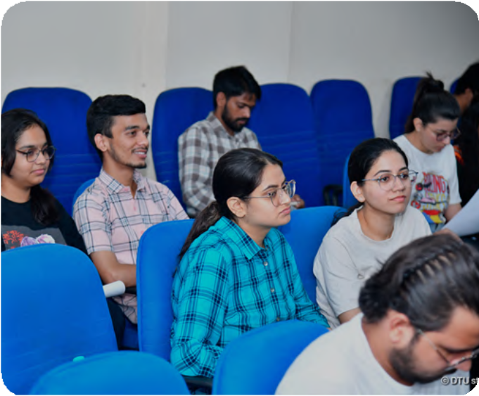

GLIMPSE OF WORKSHOP

Slide 8

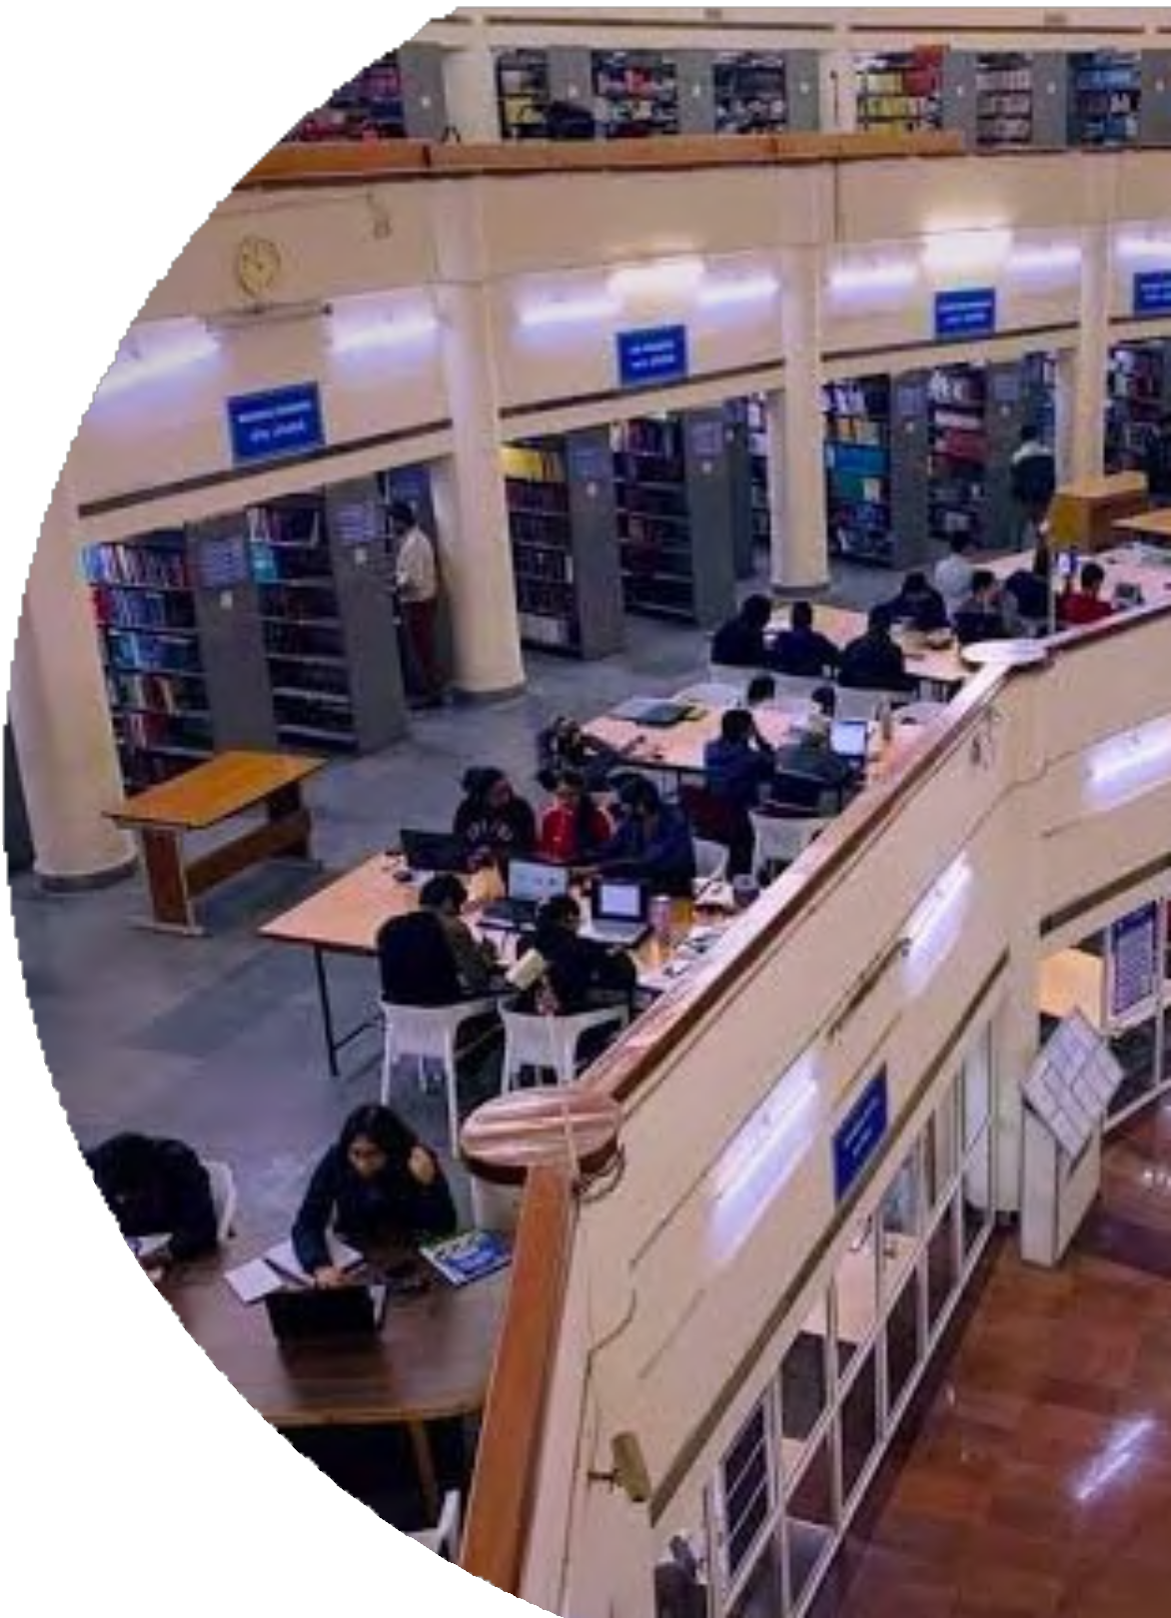

TRAINING ON SUPPORTING INNOVATION WITH THE RIGHT RESEARCH FOUNDATION: HOW THE DEPTH AND BREADTH OF THE WEB OF SCIENCE ENABLES RESEARCH SUCCESS
07.06.2023

Slide 9




INTRODUCTION
Central Library, DTU has organized an online training Programme on Supporting innovation with the right research foundation: How the depth and breadth of the Web of Science enables research success on 07.06.2023 at 10 am.
The workshop was conducted by an expert. Valentin Bogorov, Strategic Customer Success Consultant.
Dr. Lalita, Assistant Librarian coordinated the workshop under the supervision of Librarian, Prof. Rachna Garg. The Onboarding Training was a great success.

Slide 10

EXPERT SPEAKER & ORGANIZING T E A M
1
Valentin Bogorov
Strategic Customer Success Consultant
3
Dr. Lalita
Assistant Librarian
Delhi Technological University Coordinater
2
Prof. Rachna Garg
Librarian
Delhi Technological University Supervisor

Slide 11






KEY TOPICES
01
03
Explore the historical foundation of today’s breakthroughs.
Locate regionally- focused studies and results with global implications
04
02
Research institutions worldwide are aligning with the UN’s Sustainable Development Goals (SDGs), and librarians support this by giving researchers access to past and current research to drive innovative, impactful solutions.
Uncover novel applications for previous discoveries across disciplines.

Slide 12





The Growing Impact of Older Literature

Slide 13




Introduction
Central Library, DTU has organized an online training Programme on The Growing Impact of
Older Literature, on 21 Jun at 11:00 am. The workshop was conducted by an expert, Dr.
Subhasree Nag, Senior Business Solution Consultant,
Despite the enormous amounts of new literature published each year, authors are
increasingly citing older papers. This citation behavior reflects reflect major structural shifts
in the conduct of research, research funding, and transition incremental and applied
research. Giving credit to foundational publications may require authors cite an increasingly
aging literature.
To understand the citation behaviour in different disciplines and why having access to older
literature can help in generating novel ideas and open up new avenues of research.

Slide 14



1
EXPERT SPEAKER & ORGANIZING TEAM
2
Prof. Rachna Garg Librarian
Delhi Technological University Supervisor
3
Dr. Lalita Assistant Librarian
Delhi Technological University Coordinater
Dr. Subhasree Nag Senior Business Solution Consultant

Slide 15



KEY TOPICS
Citation patterns in different disciplines
Why are authors citing older papers?
Web of Science coverage and depth

Slide 16

KEY TOPICS
What can you miss without access to older literature?
Case studies

Slide 17


Training on Introduction to EndNote 21
26 June 2023

Slide 18


Introduction
Central Library, DTU has organized an online training Programme on Introduction to EndNote 21 on 26 Jun at 11:00 am. The workshop was conducted by an expert and trainer, Dr. Subhasree Nag, Regional Solutions Consultant and arranged. Dr. Lalita, Assistant Librarian coordinated the workshop under the supervision of Librarian, Prof. Rachna Garg. The Onboarding Training was a great success.
Researchers routinely collaborate on a global scale, and the ability to work remotely is increasingly important. Manually creating, maintaining, and sharing reference lists is time- consuming, particularly when managing input from collaborators. In fact, researchers worldwide waste nearly 200,000 hours per year formatting citations.

Slide 19
Introduction
Researchers routinely collaborate on a global scale, and the ability to work remotely is increasingly important. Manually creating, maintaining, and sharing reference lists is time- consuming, particularly when managing input from collaborators. In fact, researchers worldwide waste nearly 200,000 hours per year formatting citations.
learnt about how the newest version of EndNote- EndNote 21 facilitates research and manuscript writing by this webinar

Slide 20



2
EXPERT SPEAKER & ORGANIZING TEAM
3
1
Prof. Rachna Garg Librarian
Delhi Technological University Supervisor
Dr. Lalita Assistant Librarian
Delhi Technological University Coordinater
Dr. Subhasree Nag Regional Solutions Consultant

Slide 21







KEY TOPICS
EndNote™ 21 layout and functionalities
Version Comparison with EndNote 20
Integration with Google Docs
Reference Formatting using EndNote™
Enhancements to EndNote Web
1
2
3
4
5

Slide 22


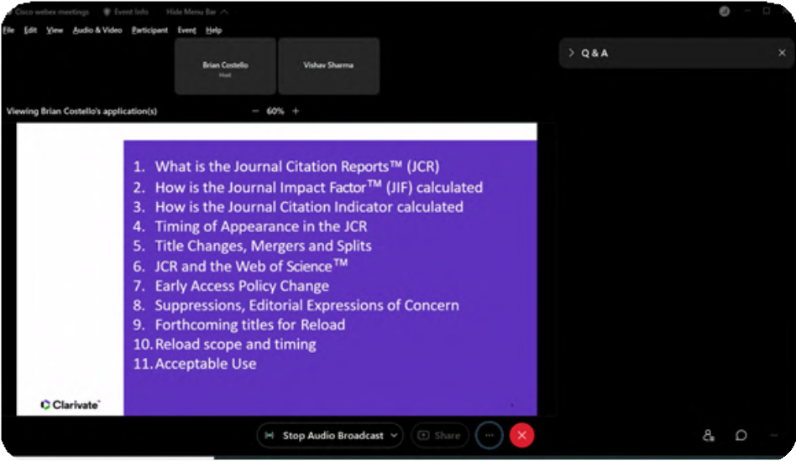
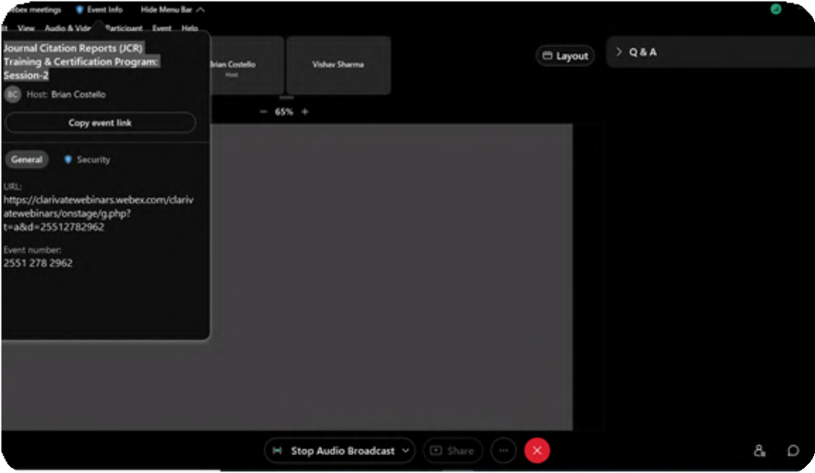
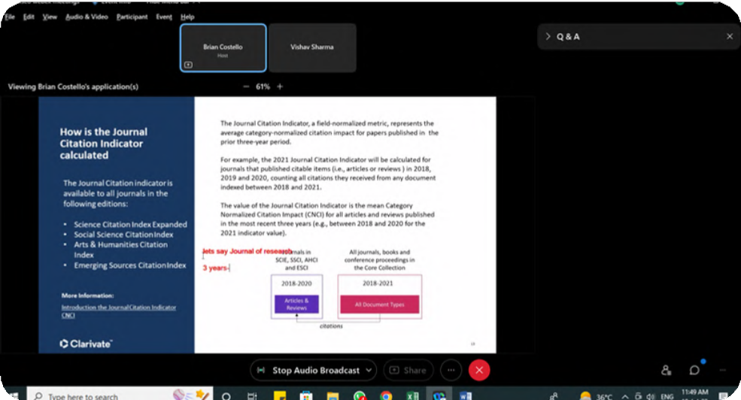
Glimpses of the Workshop

Slide 23




T R A I N I N G O N
J O U R N A L
C I T A T I O N
25.JULY.2023

Slide 24



I N T R O D U C T I O N
Central Library, DTU has organized an online training Programme on Journal Citation Reports 2023 - Dawn of a New Era by Clarivate on 25.07.2023 (Tuesday) at 11:00 a.m. The workshop was conducted by an expert and trainer, Dr. Subhasree Nag, Regional Solutions Consultant and arranged by Saurabh Srivastava, Sr. Account Manager- Govt & Academics (North India), Clarivate Analytics. Dr. Lalita, Assistant Librarian coordinated the workshop under the supervision of Librarian, Prof. Rachna Garg. The Onboarding Training was a great success

Slide 25
2
3
1
Dr. Subhasree Nag Regional Solutions Consultant
Prof. Rachna Garg Librarian
Delhi Technological University Supervisor
Dr. Lalita Assistant Librarian
Delhi Technological University Coordinater

Slide 26



K E Y T O P I C S
Expanding the Journal Impact Factor to journals indexed in the Arts & Humanities Citation Index and Emerging Sources Citation Index™
Displaying the JIF to one decimal place rather than three places
Understanding the data that underpins a journal’s performance

Slide 27
K E Y T O P I C S
Employing a wide array of metrics and descriptive statistics in your journal assessments including the Journal Citation Indicator™
Responsible use of JCR metrics

Slide 28

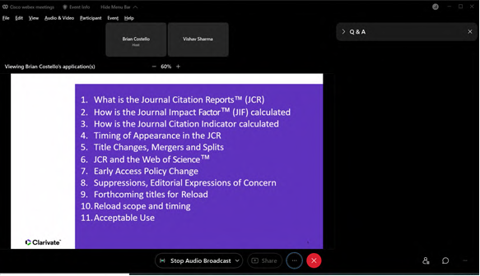
GLIMPSES OF WORKSHOP

Slide 29

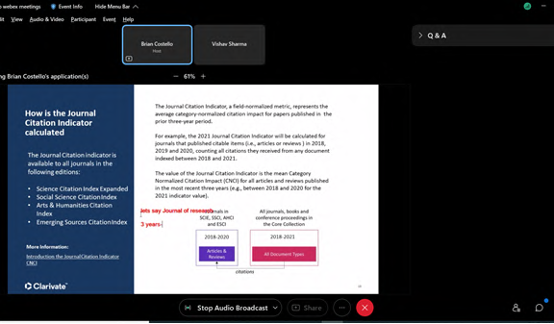
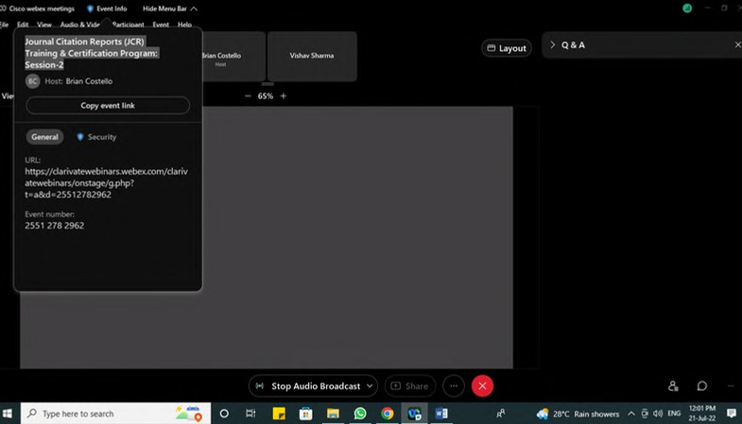

Slide 30


WEBINAR ON
ACCELERATING DRUG DEVELOPMENT - FROM DATA TO DISCOVERY
8/AUGUST/2023

Slide 31



INTRODUCTION
Central Library, DTU has organized an online training Programme on Accelerating Drug Development - From Data to Discovery on 8.8.2023 at 11:00 AM. The workshop was conducted by an expert, Dr Mandar S Bodas, Solution Consultant, Elsevier, A high performer and award-winning researcher, Mandar understands the challenges faced by the Chemistry Research community having formerly been a Senior Principal Investigator for the Biocon BMS Research Centre (BBRC), Bangalore.
Dr. Lalita, Assistant Librarian coordinated the workshop under the supervision of Librarian, Prof. Rachna Garg. The Onboarding Training was a great success.

Slide 32

INTRODUCTION
In this webinar, we had delved into the fundamentals of drug design and repurposing, discussing their significance in addressing unmet medical needs and accelerating drug development processes.
Speaker had shed light on the factors that impact drug designing, highlighting the challenges faced and potential solutions and explored the key data points required for transition compounds from hit to lead to lead optimization and mitigating various factors influencing metabolism & toxicity, which will enable their sources and integration within the drug development workflow. One of the key tools for integrating the required workflows is the Elsevier scientific database. During a live demonstration, the speaker has showcase how the scientific database is an indispensable resource for researchers, providing access to vast bibliographic data along with the physical and pharmacological properties that can significantly impact progression of compounds to clinical candidates in the drug discovery process

Slide 33






EXPERT SPEAKER & ORGANIZING TEAM
1
2
3
Dr Mandar S Bodas, Solution Consultant, Elsevier
Dr. Lalita Assistant Librarian
Delhi Technological University Coordinater
Prof. Rachna Garg Librarian
Delhi Technological University Supervisor

Slide 34


KEY TOPICS
Key factors impacting drug design, highlight the challenges faced, and offer potential solutions.
Explore the crucial data points required to transition compounds from hit to lead to lead optimization, with a focus on mitigating factors influencing metabolism and toxicity
Explore the crucial data points required to transition compounds from hit to lead to lead optimization, with a focus on mitigating factors influencing metabolism and toxicity

Slide 35






Will AI Replace the Educator?
10 august,, 2023

Slide 36







EXPERT SPEAKER & ORGANI\ING TEAM
1
2
3
4
David Lefevre
Expert
Professor of Practice, Imperial College Business School
David Shrier
Expert Managing Director Visionary Future
Professor of Practice, Imperial College Business School
Prof. Rachna Garg
Supervisior of Workshop Librarian
Delhi Technological University
Dr. Lalita
Coordinated by Assistant Librarian
Delhi Technological University

Slide 37


Introduction
Central Library, DTU has organized an online training Programme on Will AI Replace the Educator? on 10.8.2023 at 12 Noon.
Artificial Intelligence (AI) is rapidly transforming how students learn and even how educators teach. While we’re still in the early stages of realizing the vast potential of these new technologies, it doesn’t feel too soon to wonder, will AI replace teachers?
In this webinar, join esteemed professors David Lefevre and David Shrier from Imperial College Business School as they embark on an enlightening exploration of AI's potential and its profound impact on the educational landscape.

Slide 38
ABOUT EXPERTS
David Lefevre
The workshop was conducted by an expert, David Lefevre, Professor of Practice, Imperial College Business School.
David is a Professor of Practice at the Imperial College Business School where he explores the applications of AI to education.
He has a long standing interest in the use of technology in Education and formed the Business School’s Edtech Lab in 2004.

Slide 39
This award winning Lab launched Imperial College's first online courses in 2004 and Imperial College’s first online degree programme in 2015. David stepped down from leading this team in 2022 and is now focused on developing models of AI strategy, adoption, and infrastructure development.
David is actively involved in tech-transfer and entrepreneurship. In 2005, he co-founded the Imperial College spin-out Epigeum and in 2018 co-founded Insendi (now part of Study Group), a leading educational technology firm. Is 2022 he helped launch, Tutello, which is building a ‘Human+ AI’ tutoring and support platform.
David is an also Special Advisor on Digital Innovation at Study Group and a trustee of the British Council.

Slide 40
David Shrier
David Shrier, Managing Director, Visionary Future, Professor of Practice, Imperial College Business School. David Shrier is a globally recognized expert on innovation. In addition to leading venture studio Visionary Future, David is a Professor of Practice (Artificial Intelligence & Innovation) at Imperial College Business School.
David has developed $10 billion of corporate venturing opportunities with Fortune 1000 and growth equity. He previously advised the European Parliament on its AI Act. He is known for creating the four most profitable online classes in history that deployed into over 150 countries, delivering ~ US$ 1 billion in financial support to MIT, Harvard & Oxford. He previously held a rare dual appointment with MIT and with the Saïd Business School, University of Oxford.

Slide 41

David has published 8 books in the past 8 years on the technology economy. His 9th book, Basic AI, will be published by Little, Brown and Harvard Business Publishing in 2024. David Shrier was granted an Sc.B. from Brown University in Biology and Theatre.

Slide 42











KEY TOPICS COVERED
01
Unlocking the potential: demystifying AI and its applications
02
Revolutionizing higher education: harnessing AI's transformative power
03
From theory to practice: examining the current landscape of AI adoption in education
04
Navigating the future: exploring the impact of AI and automation in education

Slide 43
Link for webinar recording access
David has published 8 books in the past 8 years on the technology economy. His 9th book, Basic AI, will be published by Little, Brown and Harvard Business Publishing in 2024. David Shrier was granted an Sc.B. from Brown University in Biology and Theatre.

Slide 44


WORKSHOP ON IEEE AUTHORSHIP AND OPEN ACCESS SYMPOSIUM
TIPS AND BEST PRACTICES TO GET PUBLISHED FROM IEEE EDITORS
31/AUGUST/2023

Slide 45


INTRODUCTION
The Central Library organized an online training session on IEEE Authorship and Open Access Symposium: Tips and Best Practices to Get Published from IEEE Editors on Thursday, 31 August 2023 at 4 pm. IEEE, which will provide authors with best practices in preparing a manuscript, navigating the journal submission process, and important tips to help an author get published.

Slide 46
INTRODUCTION
This webinar included the perspective of Dr. Ashutosh Dutta of Johns Hopkins University, USA who recently served as an Assistant Technical Editor for IEEE Communications Magazine and has published numerous journal articles and conference papers with IEEE. Given his vast editorial and publishing experience, Dr. Dutta has provided critical insights on IEEE’s peer review and submission processes and tips on what editors look for in submissions. Other presenters from IEEE has also covered topics such as open access programs for institutions, research strategies using the IEEE Xplore Digital Library, author tools, and other important resources for authors.

Slide 47
EXPERT SPEAKERS & ORGANIZING TEAM
01
02 03 04
05
Ashutosh Dutta
Senior Scientist and 5G Chief Strategist
Johns Hopkins University Applied Physics Laboratory
Ranbir Sedhey
Client Services Manager IEEE
Collin Dmello
International Area Manager Bangladesh, India, Nepal and Sri Lanka IEEE
Prof. Rachna Garg
Librarian
Delhi Technological University Supervisor
Dr. Lalita Assistant Librarian Delhi Technological
University Coordinater

Slide 48

About experts
ASHUTOSH DUTTA
Ashutosh Dutta is currently a Senior Scientist and 5G Chief Strategist at the Johns Hopkins University Applied Physics Laboratory. He is currently a Senior Scientist and 5G Chief Strategist at the Johns Hopkins University Applied Physics Laboratory. He is also a Lawrence R. Hafstad Sabbatical Fellow and Professor at The Johns Hopkins University. His interests include security, mobility, software defined networking, network function virtualization, 4G/5G networks, and IoT. As a technical leader in 5G and security, Dr.
Dutta has been serving as the founding Co-Chair for the IEEE Future Networks Initiative that focuses on 5G standardization, education, publications, testbed, and roadmap activities. He also serves as IEEE Communications Society’s Distinguished Lecturer, has served as the general Co-Chair for the premier IEEE 5G World Forums, and was an Assistant Technical Editor and Guest Editor for IEEE Communications Magazine.

Slide 49
About experts
RANBIR SEDHEY
Ranbir Sedhey, Client Services Manager, IEEE
Ranbir has worked with IEEE customers in India, Middle East, Asia, Africa, and Bangladesh since 2017. Ranbir has over 13 years of experience in the information industry, previously holding positions at Dell International, HCL Learning, and Educomp Solutions Ltd.
Prior to joining IEEE, Ranbir was a Senior Manager of client engagement at Global Information Systems Technology and led a team of professionals who trained end users on various publisher products and a team who provided customer technical support.

Slide 50
About experts
COLLIN DMELLO
Collin Dmello, International Area Manager, Bangladesh, India, Nepal, Sri Lanka, IEEE
He is the IEEE International Area Manager for India, Bangladesh, Sri Lanka, and Nepal with an overall 18+ years of Information Industry experience. Since 2018, he has been helping IEEE customers across academia, government, and corporations drive innovation and collaboration using IEEE information and insights and supporting lifelong learning by providing IEEE's trusted educational services (courses and certifications). Prior to joining IEEE, he was the Chief Business Officer at GIST, where he was responsible for driving and growing their information business. He has completed his executive education from INSEAD, France, and graduated from Mumbai University

Slide 51
KEY TOPICS
How to increase the visibility and impact of research
1
Tips and best practices to improve your chances of getting published
2
3
What editors and reviewers look for in submissions

Slide 52
KEY TOPICS
Common reasons why papers are rejected
4
Selecting the right publication for research submission
5
6
Warning signs to look for to avoid predatory journals

Slide 53

KEY TOPICS
Reasons to consider Open Access journals for submissions
Open access options available from IEEE for authors and institutions
7
8
9
Research strategies using the IEEE Xplore Digital Library

Slide 54
KEY TOPICS
Authorship tools available for promoting open science
10
11
Live Q&A

Slide 55

WORKSHOP ON ACCELERATING CHEMISTRY EXCELLENCE
Insights from an Expert for Research & Education
5/sepember/2025

Slide 56


INTRODUCTION
The Central
Library organized an online training
session on Accelerating Chemistry Excellence: Insights from an Expert for Research & Education on 05.09.2023 at 10:30 am to 11:30 am.
Participants have delved into strategies and tools to
optimize their workflows, ensuring them remain at the forefront of impactful discoveries.

Slide 57

EXPERT SPEAKERS & ORGANIZING TEAM
1
Dr. Mandar Bodas Scientific Solution Sales/Consult ing
Elsevier
2
Jack Kay Clegg Professor of Inorganic Chemistry· The University of Queensland
3
Prof. Rachna Garg Librarian Delhi Technologica l University Supervisor
4
Dr. Lalita Assistant Librarian Delhi Technologica l University Coordinater

Slide 58
DR. MANDAR DOBAS
Dr. Mandar Bodas is a highly accomplished professional with a proven track record of scientific achievements in research and development (R&D). He has a strong background in chemistry and has made significant contributions in the field of organic synthesis, medicinal chemistry, and drug discovery. Dr. Bodas holds a Doctor of Philosophy (Ph.D.) in Chemistry from the National Chemical Laboratory in Pune. His doctoral research focused on the development of synthetic methodologies employing phosphorus ylides and synthetic studies towards various compounds. He also holds a Post Graduate Diploma in Business Management from The Maharaja Sayajirao University and a Master's degree in Organic Chemistry from the same university.
ABOUT SPEAKERS

Slide 59
DR. MANDAR DOBAS
Throughout his career, Dr. Bodas has demonstrated expertise in diverse areas of organic synthesis, including asymmetric and chiron approaches, transition-metal mediated organic transformations, and combinatorial library synthesis. He has experience with various chemistry software and informatics tools, including REAXYS, SCIFINDER, ChemOffice, and Spotfire. Dr. Bodas has held significant
ABOUT SPEAKERS
positions in renowned organizations. From 2008 to September 2018, he worked at Biocon BMS Research Centre (BBRC) in Bangalore as a Senior Principal Investigator. In this role, he directed a team and was responsible for project direction, design of new molecular entities, hit/lead optimization, and publication of results in the therapeutic areas of fibrosis, heart failure, atherosclerosis, and depression.

Slide 60
DR. MANDAR DOBAS
ABOUT SPEAKERS
Prior to his tenure at BBRC, Dr. Bodas worked as a Senior Research Scientist at Ranbaxy Laboratories Ltd., where he focused on the design and synthesis of kinase inhibitors and combinatorial library synthesis for oncology. Currently, Dr. Bodas serves as a Solution Consultant at Elsevier, where he addresses academic, government, and educational institutes in South Asia, South East Asia, and ANZ regions. He promotes Elsevier's chemical and life science portfolio.

Slide 61
Professor of Inorganic Chemistry· The University of Queensland
JACK KAY CLEGG
ABOUT SPEAKERS
Jack Kay Clegg (&#64;JackKClegg) is a Professor of Inorganic Chemistry at The University of Queensland. Jack studied Chemistry, History and German graduating with a Bachelor of Liberal Studies (Honours) and a University Medal from the University of Sydney. He went on to complete a PhD in Chemistry (2008) and a Bachelor of Laws (2009). After completing his studies Jack won a Marie Curie Fellowship to conduct research at the University of Cambridge. Jack joined UQ in 2012 and was an ARC Future Fellow 2014-2018. In 2018 Jack was awarded the Malcolm McIntosh Prize for Physical Scientist of the Year.

Slide 62

DTU Central Library Hosts Educational Visit for Eshan
College Students
18th September, 2023

Slide 63

Introduction
By the office order of Prof. Amit Srivastava, Dean, OEA, central Library, DTU organized a library visit of Eshan College of Engineering Agra-Mathura Highway, Distt Mathura, UP on 18.09.2023 at 11:30 am.
The students were briefed by Dr. Lalita, Assistant Librarian about the collection, users and services of the library including the electronic resources. The students were quite impressed with the collection and services of the library.

Slide 64

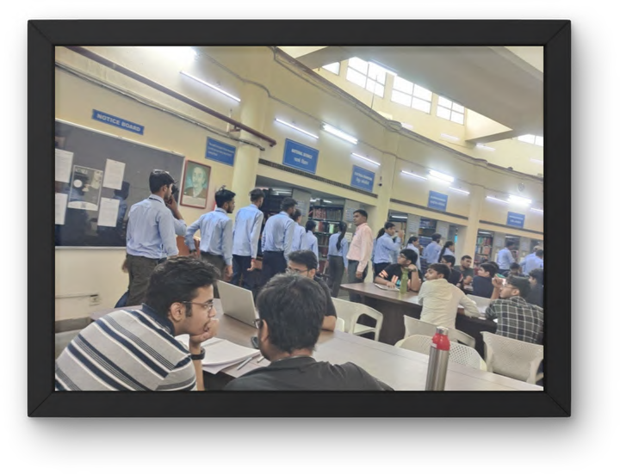
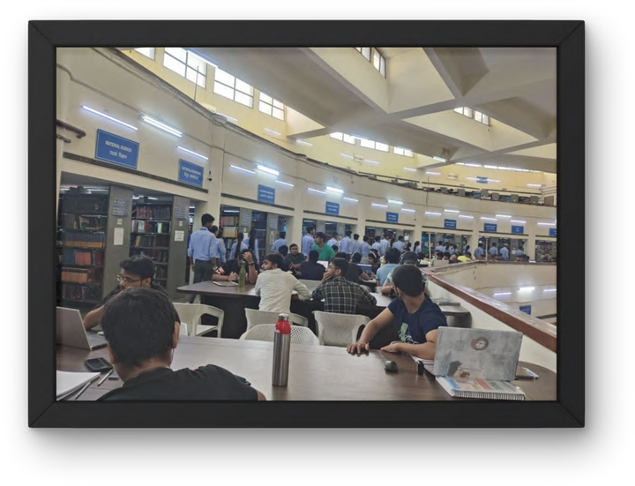
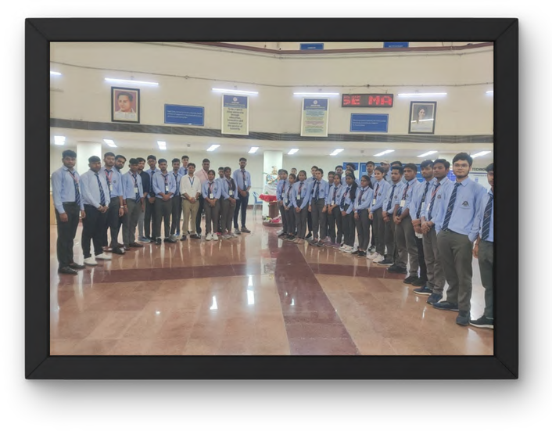

Slide 65
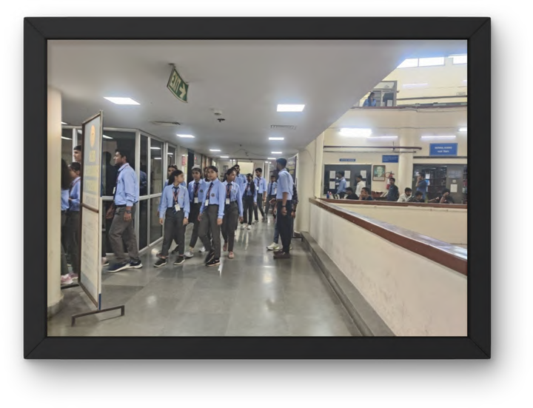
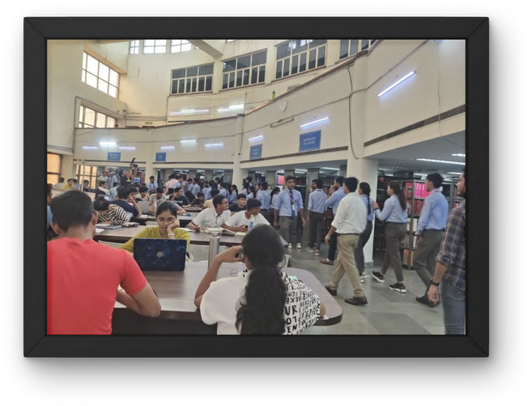
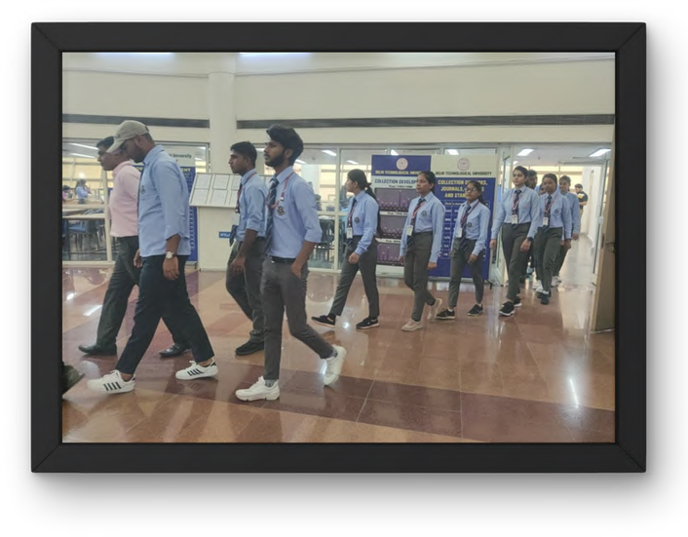

Slide 66





E-RESOURCES A GATEWAY FOR RESEARCH, 7TH EDITION (2023)
FROM 25-29 SEPTEMBER 2023

Slide 67
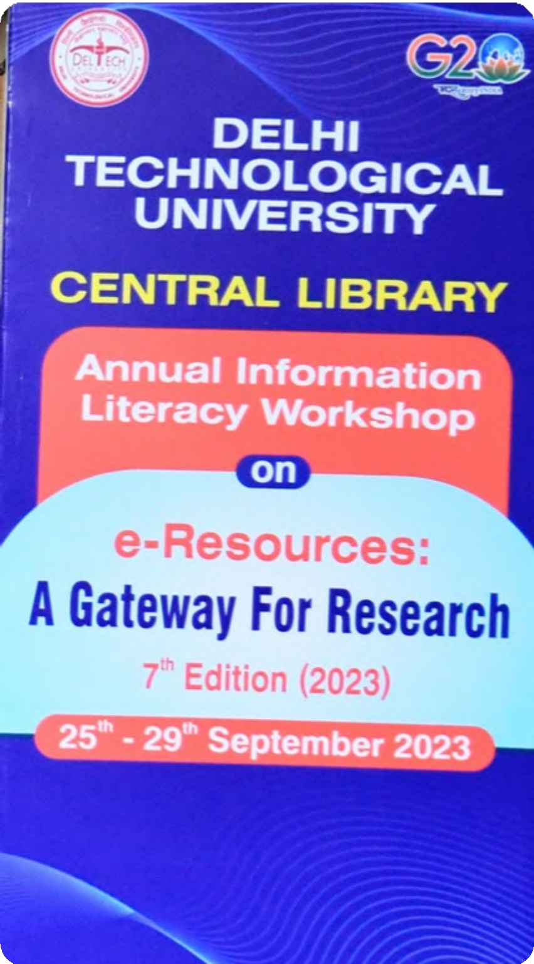
E-Resources A
The Central Library, Delhi Technological University has
been spending substantial amount to subscribe number of
databases besides getting access from the e-Sodh-Sindhu
(INFLIBNET). In order to optimize the uses of these e-
Gateway
resources, the library organizes online/offline information
literacy programs. These information literacy programs
create awareness and clear the doubts of library users
while using.
Keeping the tradition live, the Central Library organized a
five days’ information literacy workshop - E-Resources: A
for Research
Gateway for Research - from 25th - 29th September 2023

Slide 68

E-Resources A
1
Create awareness about the
electronic resources being
subscribed or accessible from e-
ShodhSindhu among the library users
especially new users.
Gateway
2
Develop effective search
strategies to locate information of
their choice.
for Research
Make choices as to what type of
3
information would be relevant for
the topic, and where and how to
locate that information

Slide 69
E-Resources A
4
Use different platforms for retrieving
precise information
Gateway
5
Locate and retrieve the needed
information
Critically evaluate the
6
information’s usefulness, quality,
and relevance
for Research
Organize, synthesize and
7
communicate the information in
a meaningful, coherent way

Slide 70

Create their own digital library.
E-Resources A
8
Gateway
9
Write quality article/project report.
Cite all the information resources
10
correctly that have been
for Research
consulted.

Slide 71


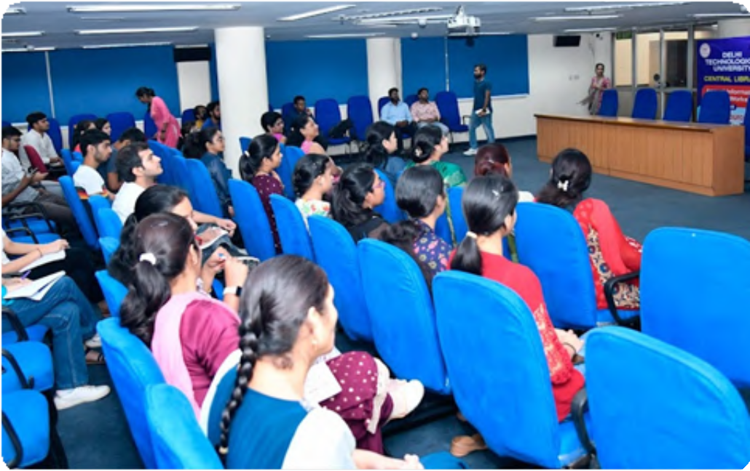
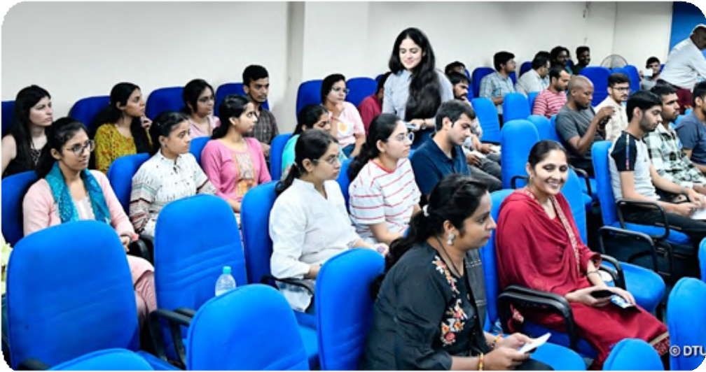
E-Resources A
The Workshop received an excellent
response from Professors, Associate
Gateway
Professors,
Assistant
Professors,
Research Scholars, PG students, UG
students and library staff and approx
267 registered themselves for the
Workshop by Google form.
for Research

Slide 72

E-Resources A
The inaugural function was held on 25th September, 2023 and graced by Hon’ble Registrar,
Professor Madhusudan Singh, as Chief Guest of the Workshop. Professor S.K. Garg,
Chairman, Library Advisor Committee graced the occasion as Guest of Honor. The
distinguish Professor Rachna Garg registered her presence as University Librarian and Dr.
Jayasimhardri as Deputy Librarian. Dr. Lalita, Assistant Librarian anchored and coordinated the Inaugural function.
Gateway
Librarian, Professor Rachna Garg welcomed all the dignitaries and participants and
outlined the objectives and schedule of the workshop. Books and Sapling were presented
to the guests as mark of token respect. Prof S.K. Garg spoke about the initiatives taken by
the Central Library
Hon’ble Registrar, Professor Madhusudan Singh, then inaugurated the workshop and gave
for Research
inaugural address the workshop as Chief Guest. Dr. Jayasimhadri presented vote of
thanks.
The participants attended the inaugural function include Professors, Associate Professors,
Assistant Professors, Research Scholars, PG students and UG students. The inauguration
was followed by high tea.

Slide 73
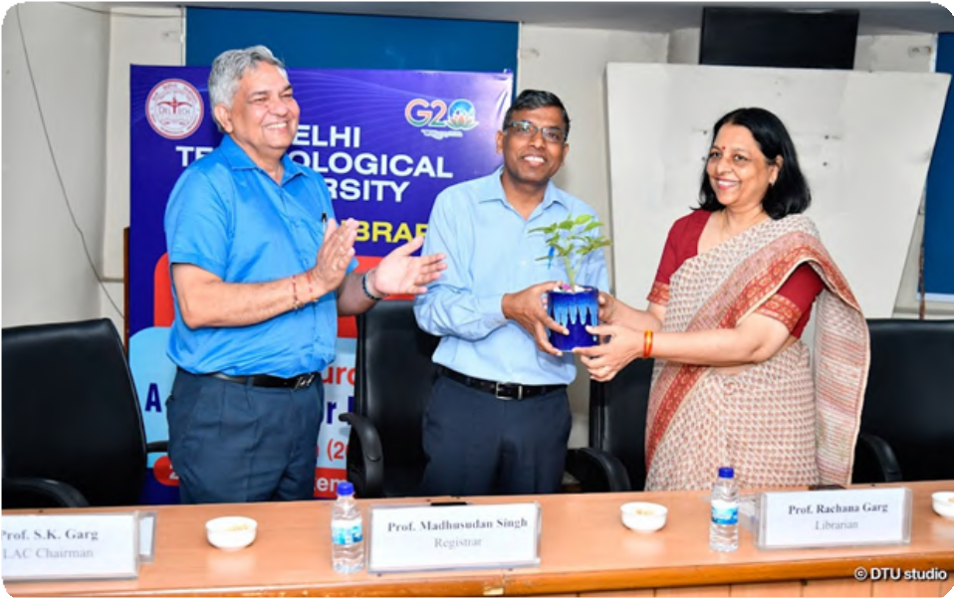
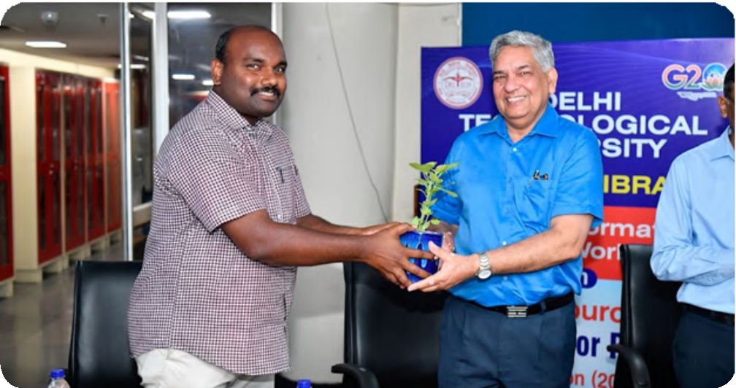
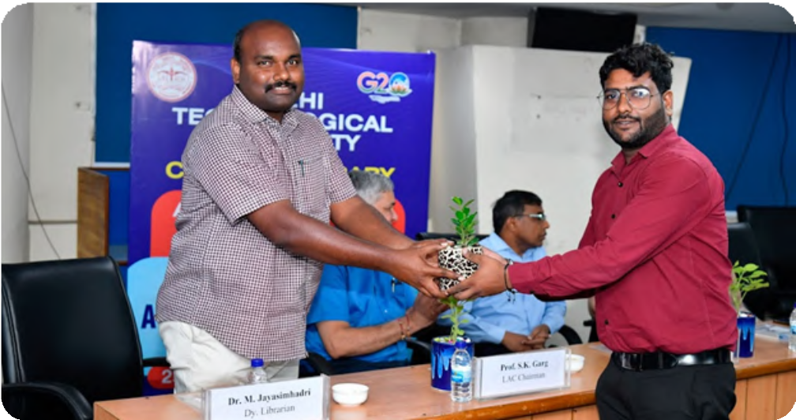
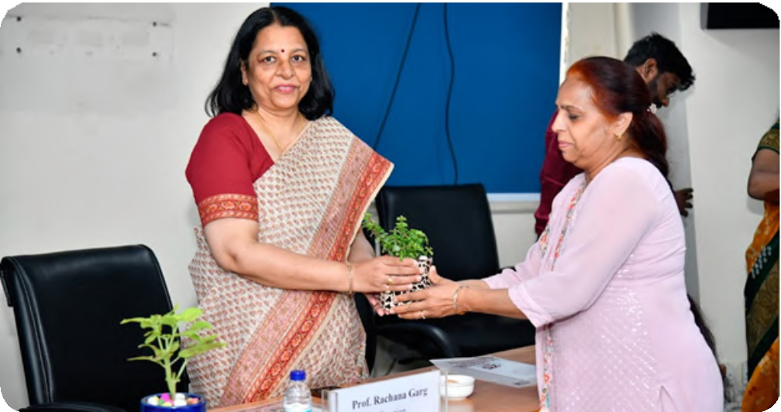
E-Resources A
-Reso
rces A
Gateway
for Research
for Re
earch

Slide 74

E
E-Resources A
In the beginning, Dr. Lalita, Ass
istant Librarian and coordinator of
the workshop gave presentation about the various library collections, and activities. She highlighted the various
Gateway
databases, subscribed by the DTU or accessible through
eShodhSindhu.
14 technical sessions were organized during the five days. In
each technical session, experts made their presentations about
databases/ software. They highlighted different natty gritty of
for Research
database/ software with live demo. The day-wise presentations
on the databases/ software were as follows

Slide 75
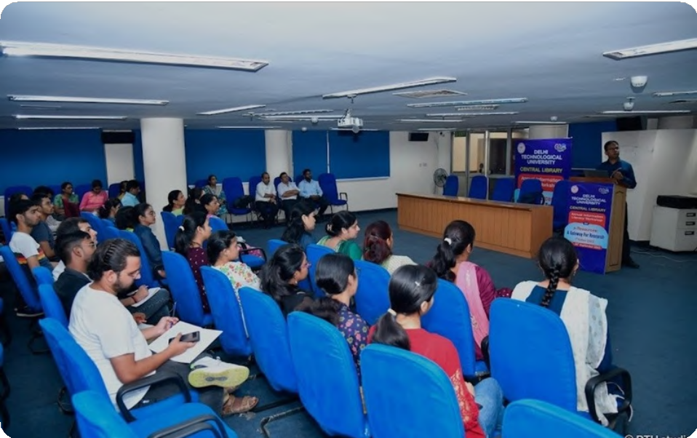
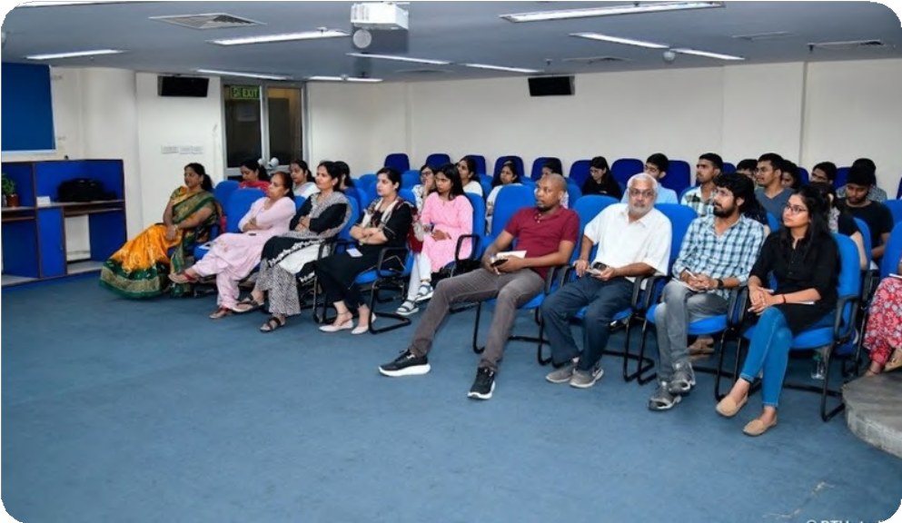
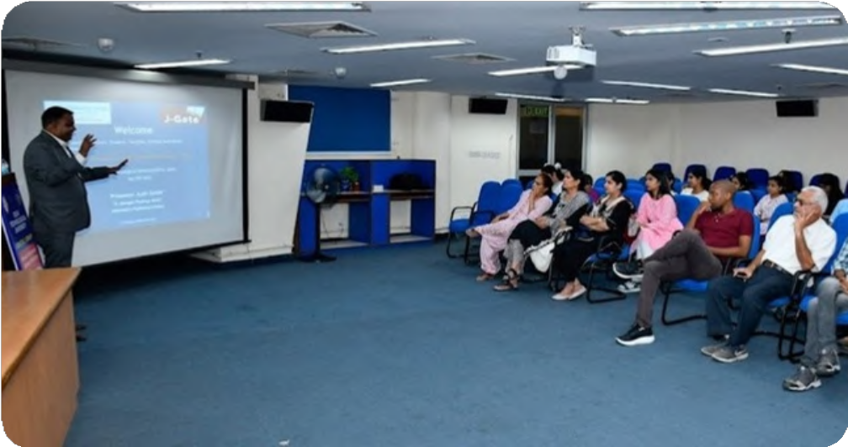
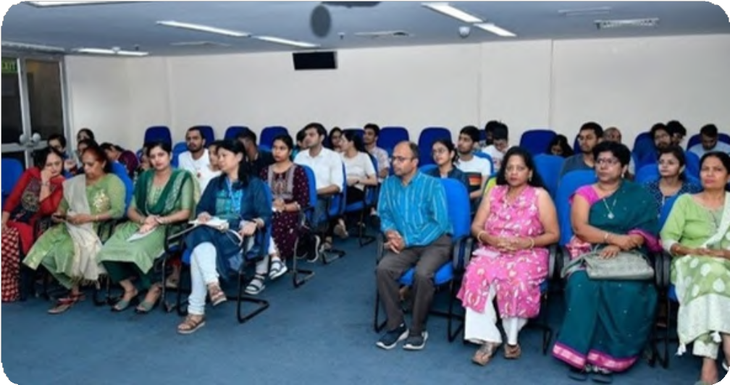
;
E-Resources A
Gateway
for Research
For Resarch

Slide 76

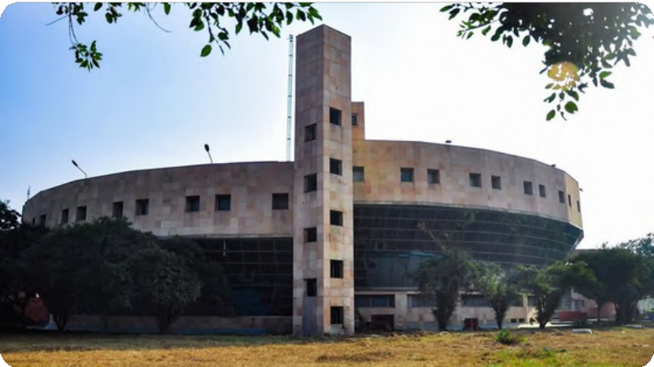


Inauguration and Library presentation
DAY 1
E-Resources A
Elsevier e-books
Gateway
Engineering Village
J-Gate
for Research

Slide 77




Nature & Springer
DAY 2
E-Resources A
RemoteXs
Gateway
T&F
T&F e-books
for Research

Slide 78





IEEE
DAY 3
E-Resources A
Pearson e-books
Gateway
Web of Science
CBS e-books
for Research

Slide 79


Turnitin
DAY 4
E-Resources A
DELNET
Gateway
for Research

Slide 80
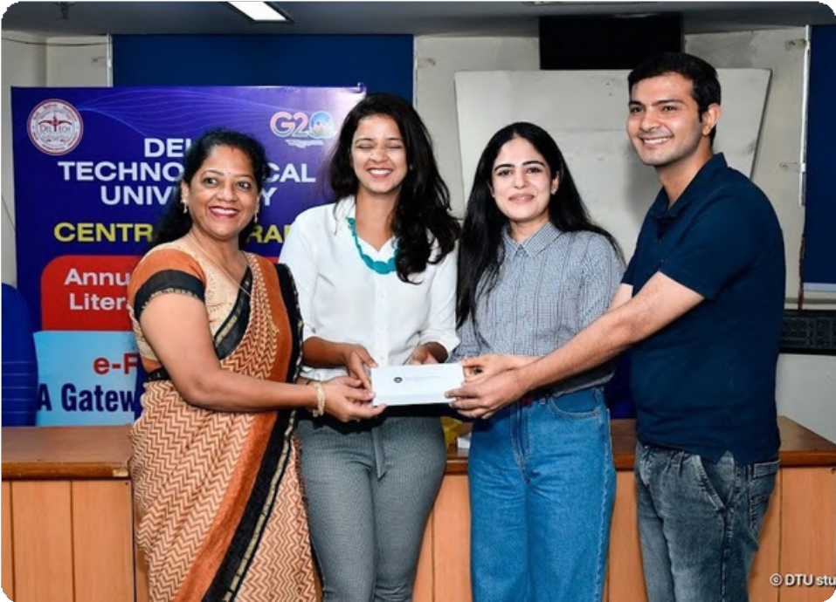
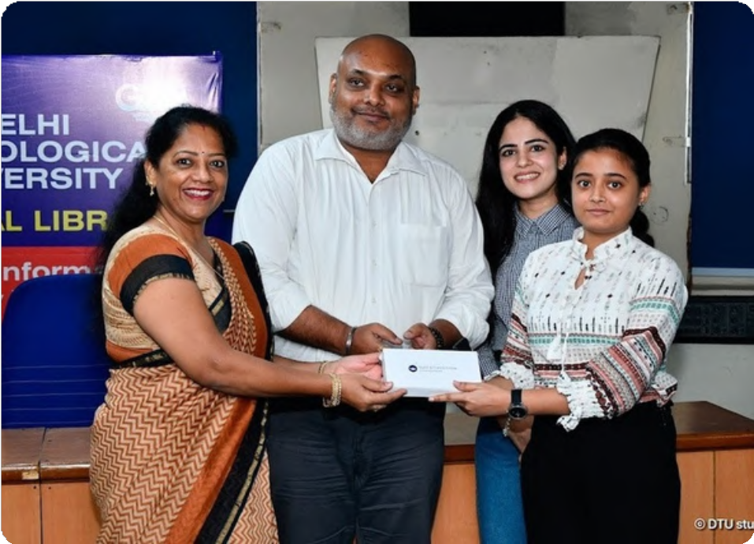
‘
E-Resources A
At the end certificates were distributed to the participants who
attended the workshop.
Gateway
for Research

Slide 81
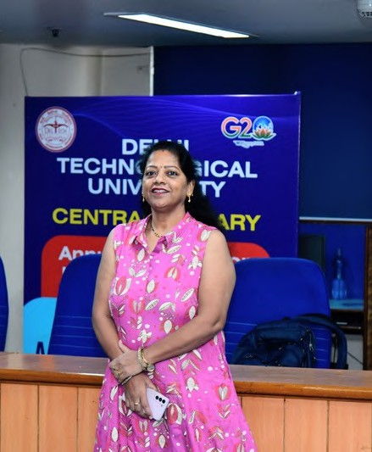
]
E-Resources A
At the end Dr. Lalita, Coordinator of the Workshop, presented a vote of thanks, thanking all those who contributed directly and indirectly to the success of the workshop.
Gateway
Gateway
for Research

