Slide 1
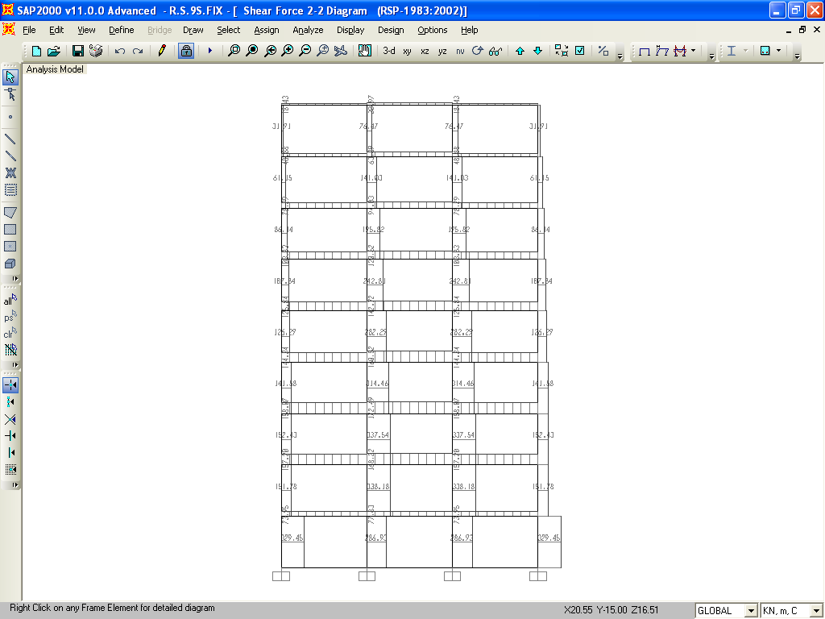
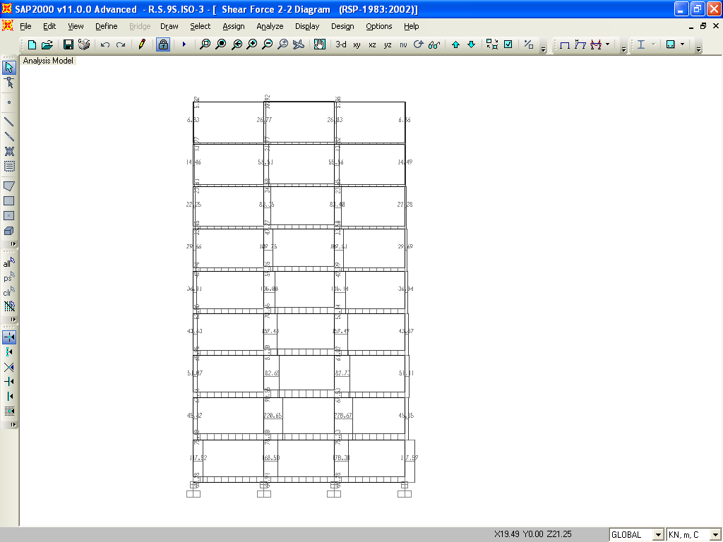
5.3 S.F.DIAGRAM OF FIXED & BASE-ISOLATED 4, 6 & 9 STOREYED BUILDING
S.F.DIAGRAM OF FIXED BASE 9 STOREY BUILDING
Fig 5.11
S.F.DIAGRAM OF BASE-ISOLATED 9 STOREY BUILDING
RSP 1893-2022 PART-I CASES COMPARISION

Slide 2
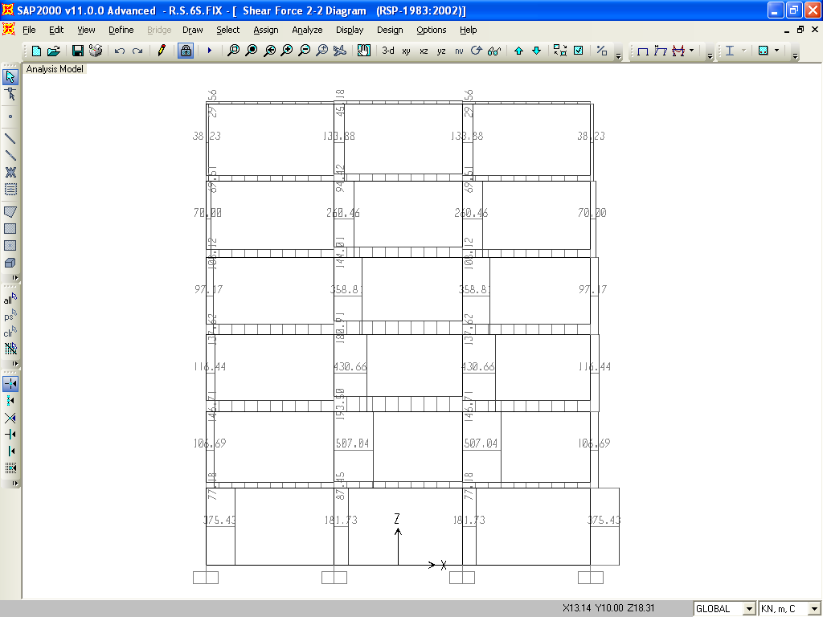
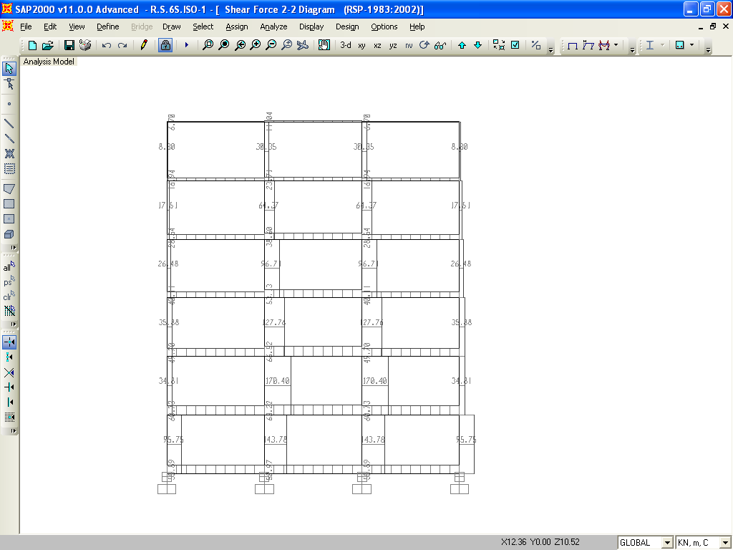
S.F.DIAGRAM OF FIXED BASE 6 STOREY BUILDING
Fig 5.12
S.F.DIAGRAM OF BASE-ISOLATED 6 STOREY BUILDING
RSP 1893-2002 PART-I CASES COMPARISION

Slide 3
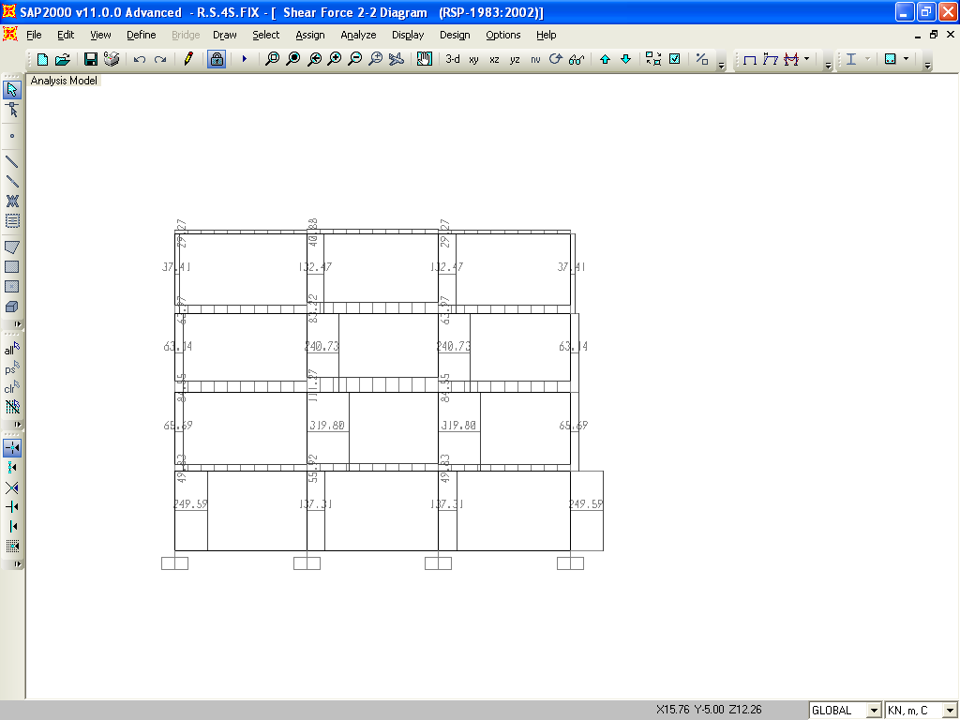
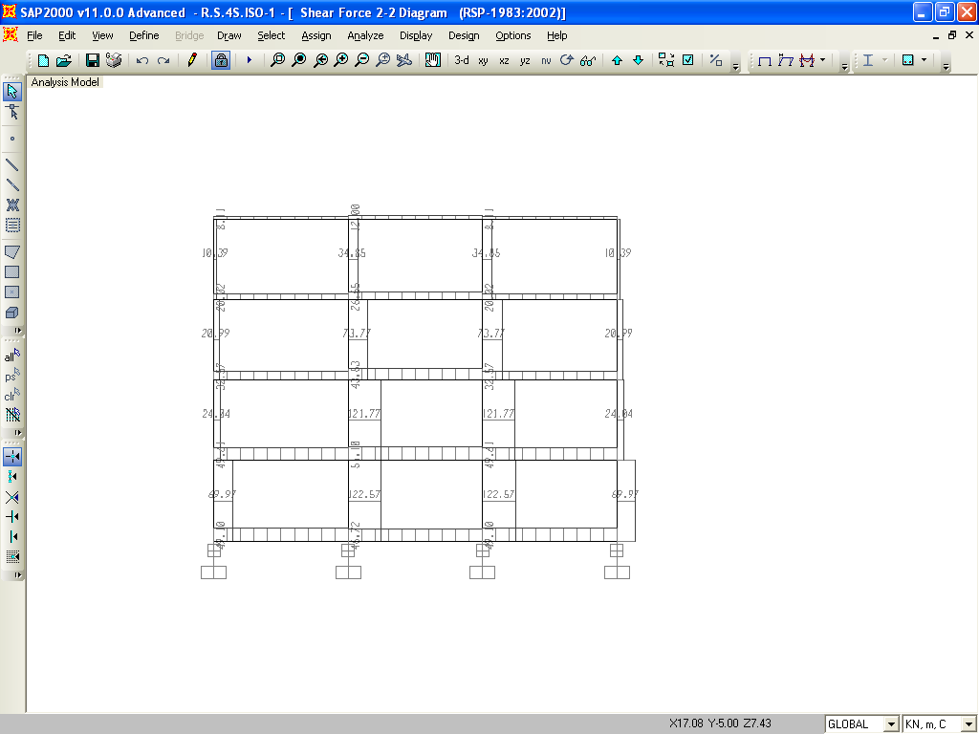
S.F.DIAGRAM OG FIXED BASE 4 STOREY BUILDING
Fig 5.13
S.F.DIAGRAM OF BASE-ISOLATED 4 STOREY BUILDING

Slide 4
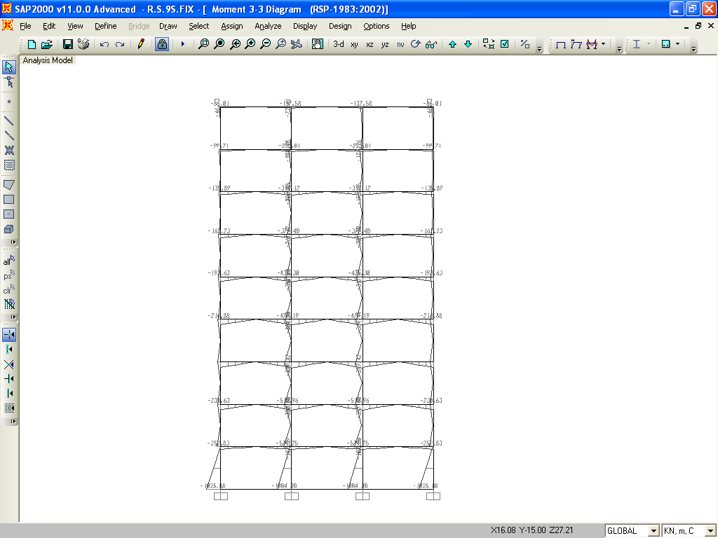
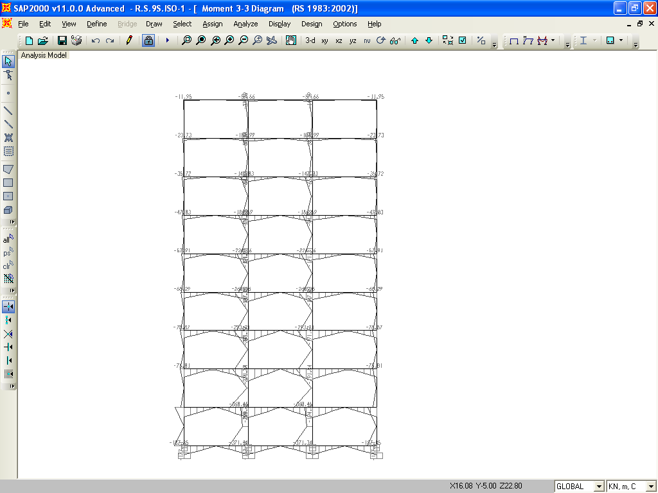
5.4 B.M. DIAGRAM OF FIXED AND BASE-ISOLATED 4, 6 & 9 STOREYED BUILDINGS
B.M.DIAGRAM OF FIXED BASE 9 STOREY BUILDING
Fig 5.14
S.F.DIAGRAM OF BASE-ISOLATED 4 STOREY BUILDING
RSP 1893-2002 PART-I, CASES COMPARISION

Slide 5
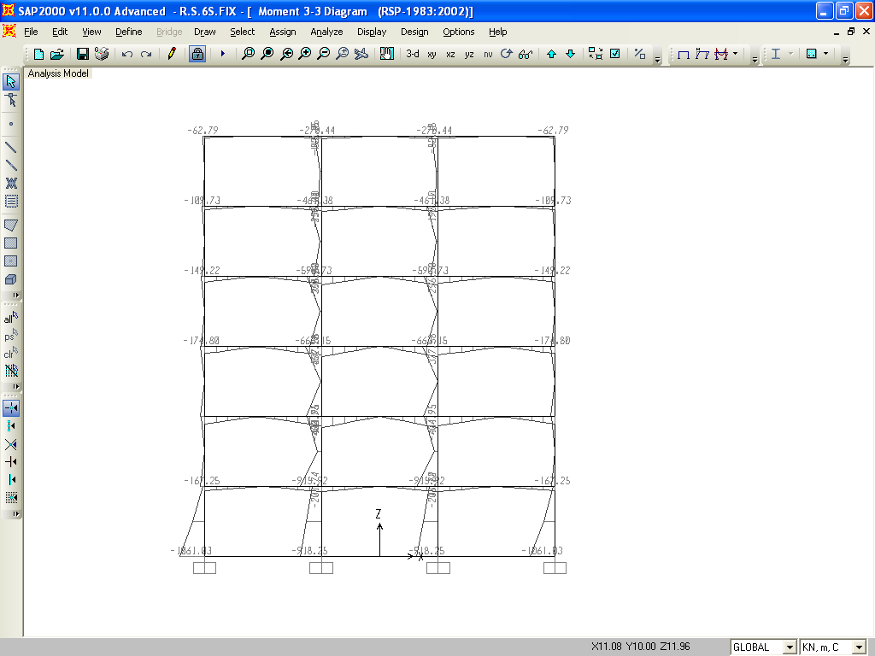
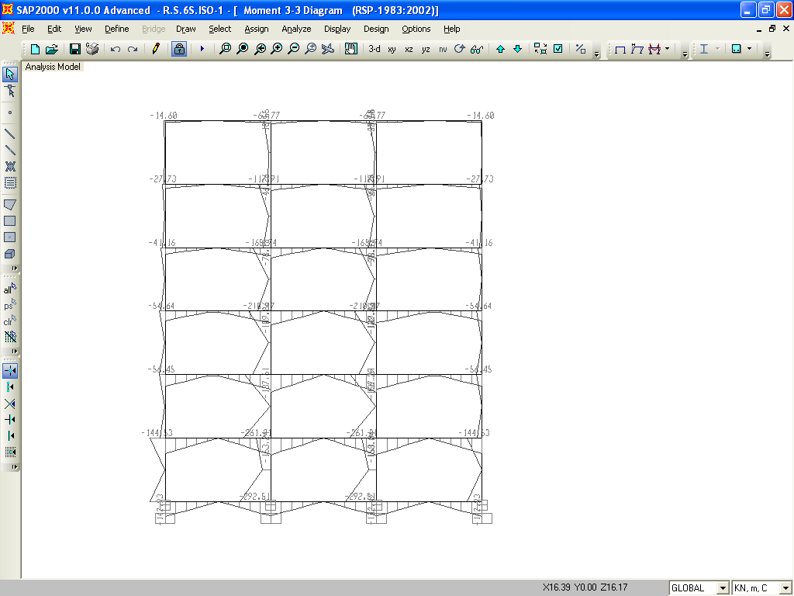
B.M.DIAGRAM OF FIXED BASE 6 STOREY BUILDING
Fig 5.15
B.M.DIAGRAM OF BASE-ISOLATED 6 STOREY BUILDING
RSP 1893-2002 PART –I CASES COMPARISION

Slide 6
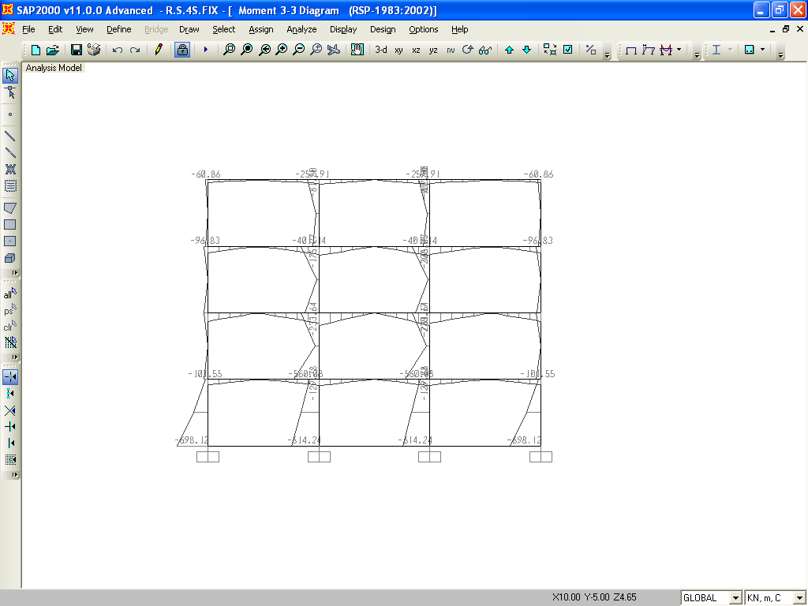
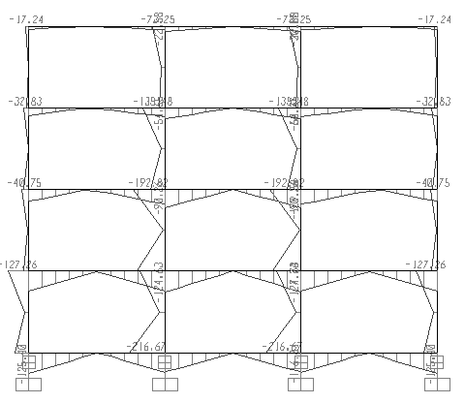
B.M.DIAGRAM OF FIXED BASE 4 STOREY BUILDING
Fig 5.16
B.M.DIAGRAM OF BASE-ISOLATED 4 STOREY BUILDING
RSP 1893-2002 PART-I CASES COMPARISION

Slide 7
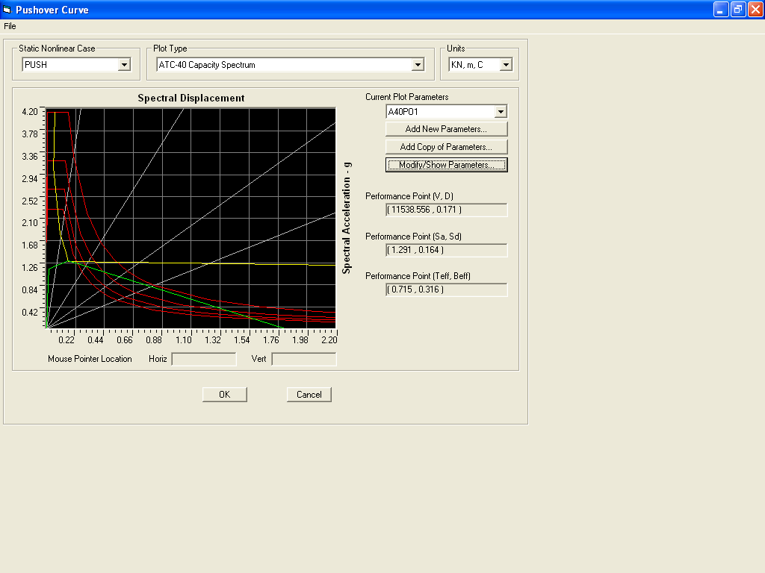
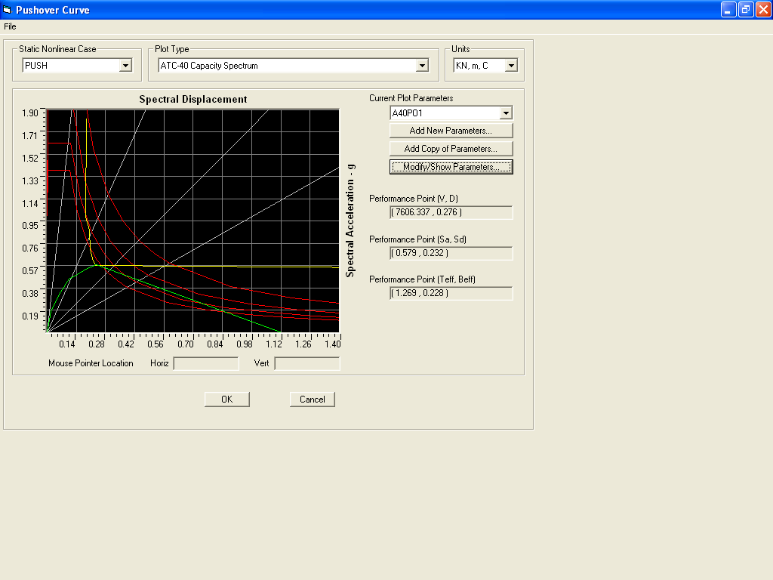
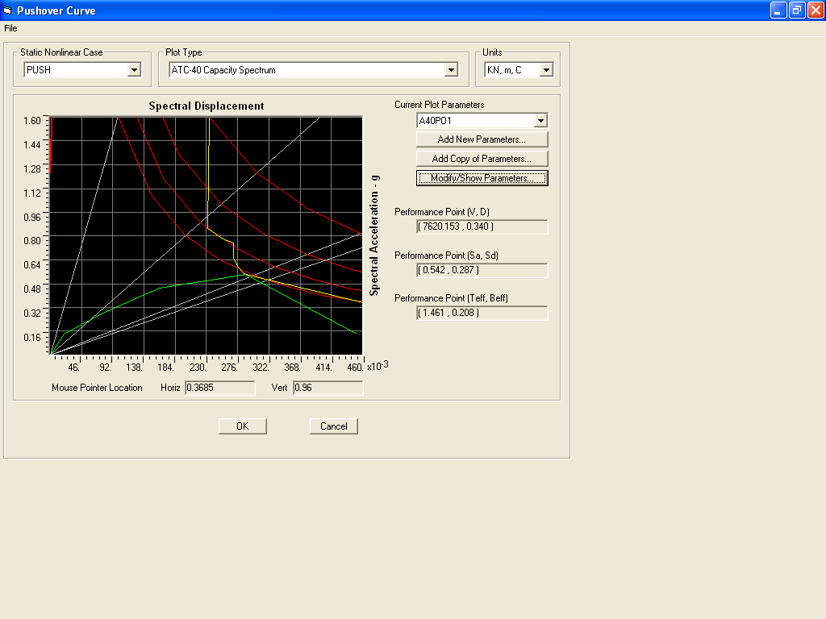
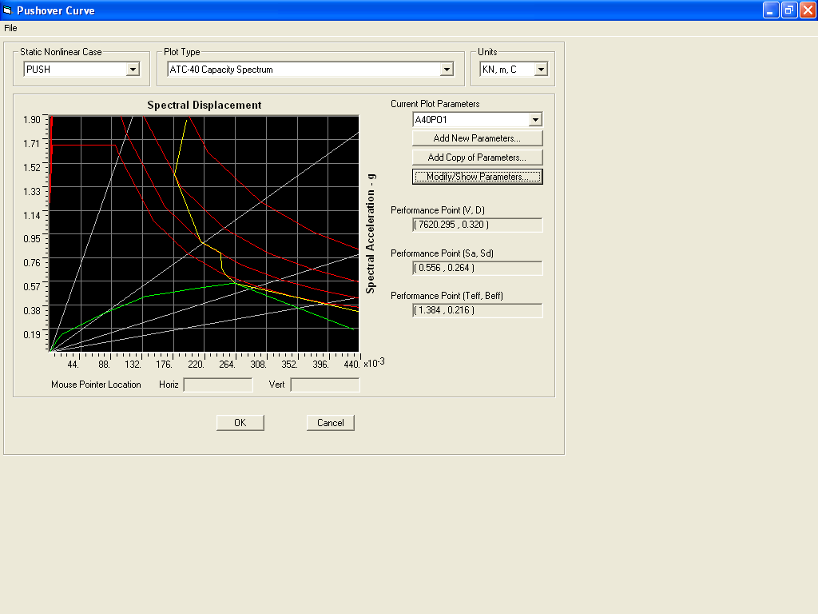
5.5 PERFORMENCE POINTS OF FIXED AND BASE-ISOLATED 4, 6 & 9 STOREYED BUILDINGS [RSP CASES]
FOUR STOREY BUILDING WITH FIXED BASE
FOUR STOREY BUILDING WITH EQUAL STIFFNESS ISOLATORS BASE
FOUR STOREY BULDING WITH UNEQUAL STIFFNESS OF ISOLATORS BASE
FOUR STOREY BUILDING WITH STIFFNESS OF ISOLATORS IN THE RATIO OF COL .MASS
Parameters of Performance Points of Four Storey Buildings with different base conditions
V= | 11538.56 KN | 7606.34 KN | 7620.15 KN | 7620.30 KN
D= | 0.171 M | 0.276 M | 0.340 M | 0.230 M
Sa= | 1.291 | 0.579 M | 0.542 | 0.556
Sd = | 0.164 | 0.232 | 0.287 | 0.264
Teff = | 0.715 Second | 1.269 Seconds | 1.461 Seconds | 1.384 Seconds
Beff = | 31.6 % | 22.80 % | 0.208 % | 21.6 %
WHERE V = Base shear, D= Displacement, Sa = Acceleration Spectrum, Sd = Displacement Spectrum, Teff = Effective time and Beff = Effective Damping
COMPARISION OF RSP CASES FOUR STOREY BUILDINGS’S PERFORMENCE POINTS WITH DIFFERENT BASE CONDITIONS
Fig 5.17

Slide 8
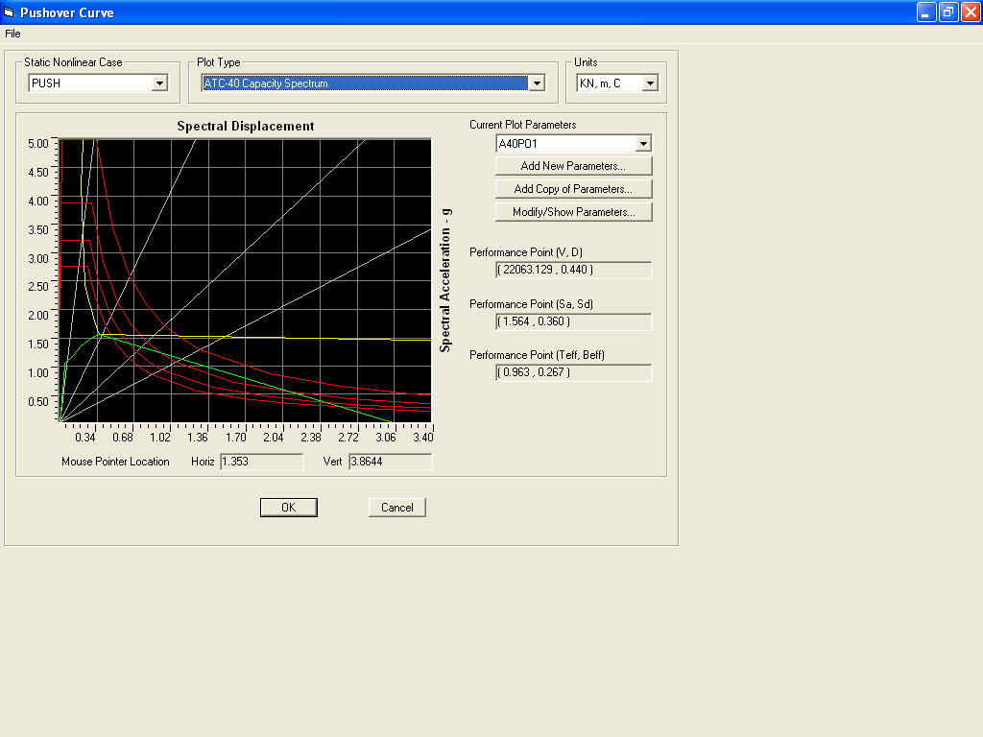
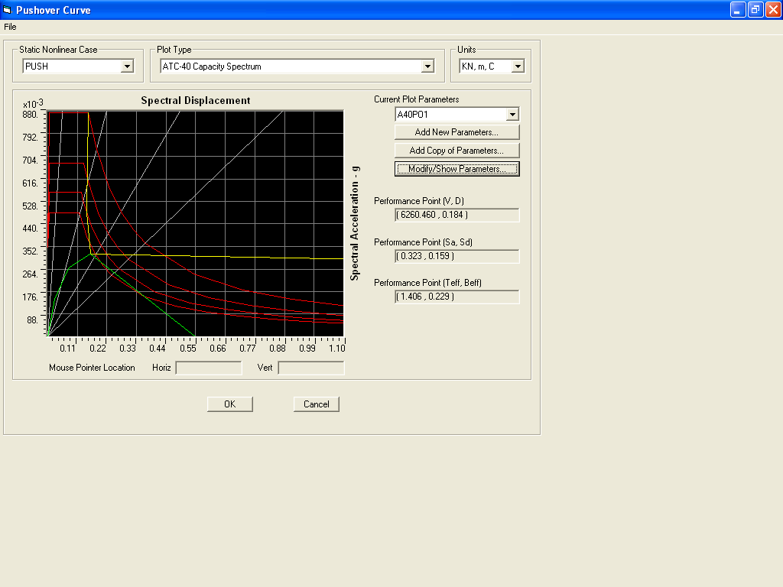
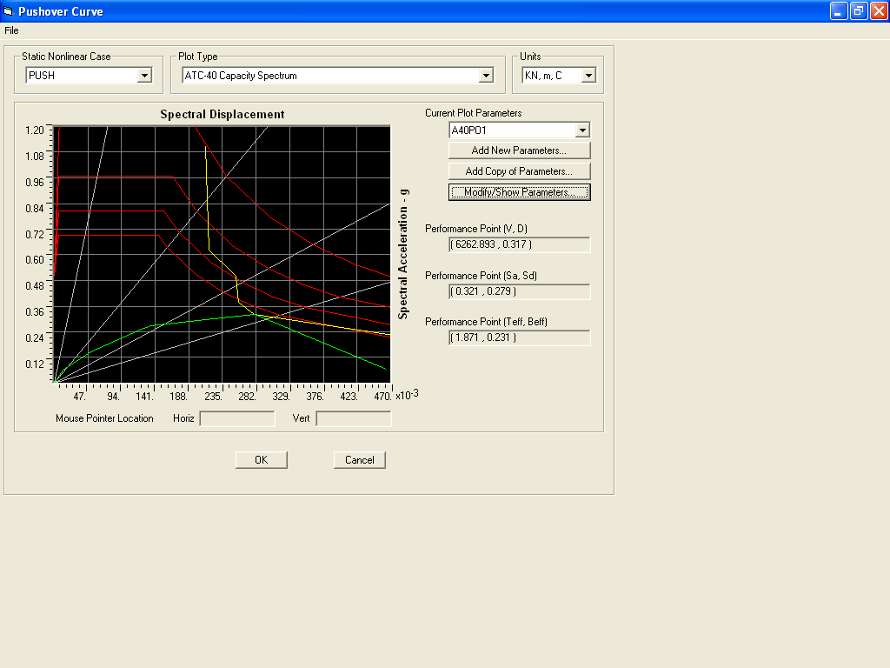
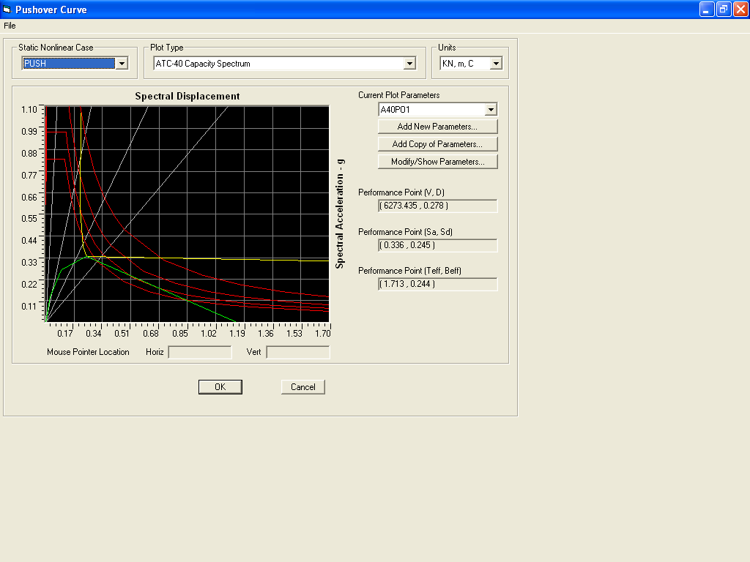
Fig 5.18
SIX STOREY BUILDING WITH FIXED BASE
SIX STOREY BUILDING WITH EQUAL STIFFNESS ISOLATORS BASE
SIX STOREY BULDING WITH UNEQUAL STIFFNESS OF ISOLATORS BASE
FOUR STOREY BUILDING WITH STIFFNESS OF ISOLATORS IN THE RATIO OF COL .MASS
Parameters of Performance Points of Six Storey Buildings with different base conditions
V= | 22063.13 KN | 6260.46 KN | 6262.89 KN | 6273.44KN
D= | 0.440 M | 0.184 M | 0.317 M | 0.278 M
Sa= | 1.564 | 0.323 | 0.321 | 0.336
Sd = | 0.360 | 0.159 | 0.279 | 0.245
Teff = | 0.963 Second | 1.406 Seconds | 1.871 Seconds | 1.713 Seconds
Beff = | 26.70 % | 22.90 % | 23.1 % | 24.40 %
WHERE V = Base shear, D= Displacement, Sa = Acceleration Spectrum, Sd = Displacement Spectrum, Teff = Effective time and Beff = Effective Damping
COMPARISION OF RSP CASES SIX STOREY BUILDINGS’S PERFORMENCE POINTS WITH DIFFERENT BASE CONDITIONS

Slide 9
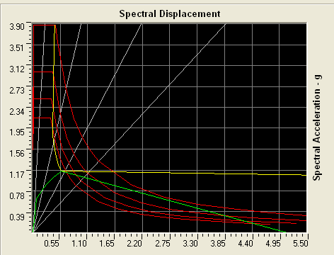
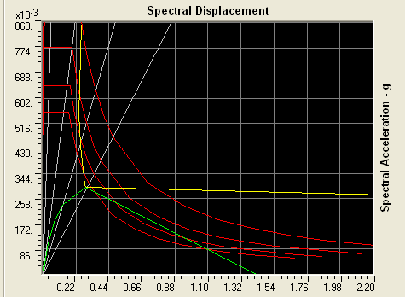
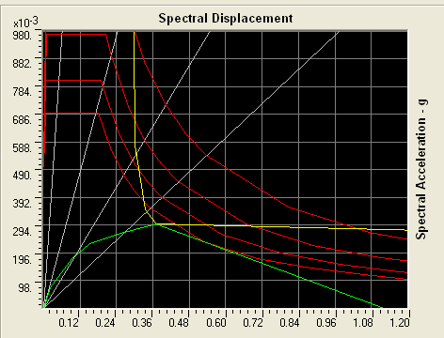
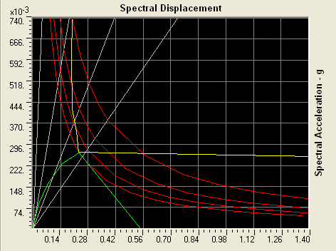
NINE STOREY BUILDING WITH FIXED BASE
NINE STOREY BUILDING WITH EQUAL STIFFNESS ISOLATORS BASE
NINESTOREY BULDING WITH UNEQUAL STIFFNESS OF ISOLATORS BASE
NINE STOREY BUILDING WITH STIFFNESS OF ISOLATORS IN THE RATIO OF COL .MASS
Parameters of Performance Points of 6 Storey Buildings with different base conditions
V= | 20665.29 KN | 7583.64 KN | 7437.70 KN | 7371.67 KN
D= | 0.734 M | 0.340 M | 0.435 M | 0.279 M
Sa= | 1.147 | 0.297 | 0.298 | 0.267
Sd = | 0.568 | 0.286 | 0.370 | 0.232
Teff = | 1.411 Second | 1.968 Seconds | 2.237 Seconds | 1.869 Seconds
Beff = | 24.30 % | 22.80 % | 23.40 % | 20.20 %
WHERE V = Base shear, D= Displacement, Sa = Acceleration Spectrum, Sd = Displacement Spectrum, Teff = Effective time and Beff = Effective Damping
COMPARISION OF RSP CASES NINE STOREY BUILDINGS’S PERFORMENCE POINTS WITH DIFFERENT BASE CONDITIONS
Fig 5.19

